Slide 1

Topic: Unit 5 Course Name: Industrial Automation and Control(20EE11Q3)
Dr. Kavirayani Srikanth
Asst. Professor
Dept. of EEE

Slide 2
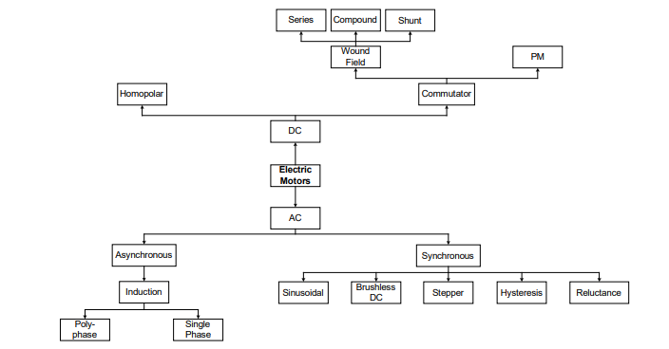
Classification

Slide 3
Introduction
Motion control and drives are very important actuation subsystems for process and discrete manufacturing industries.
Motion control systems are critical for product quality in discrete manufacturing, while variable speed drives lead to significant energy savings in common industrial loads such as pumps, compressors and fans.

Slide 4
Introduction
Variable speed drives can be categorized into adjustable speed drives and servo drives.
In adjustable speed drives the speed set points are changed relatively infrequently, in response to changes in in process operating points.

Slide 5
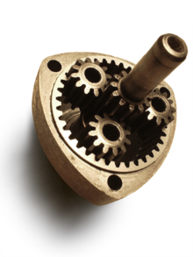
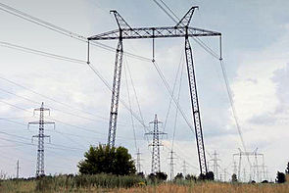
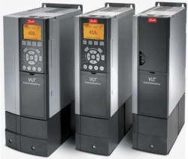
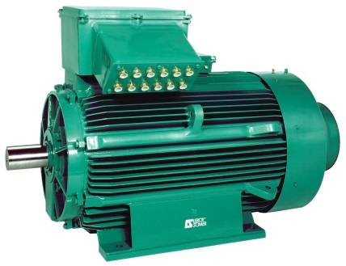
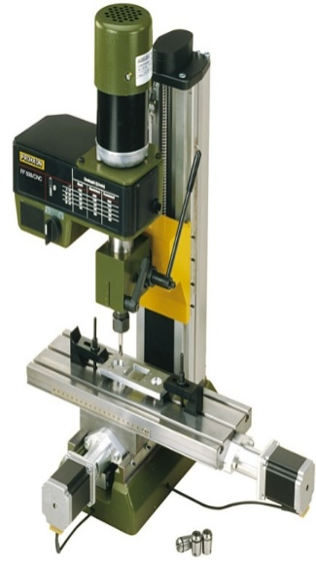
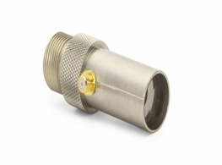
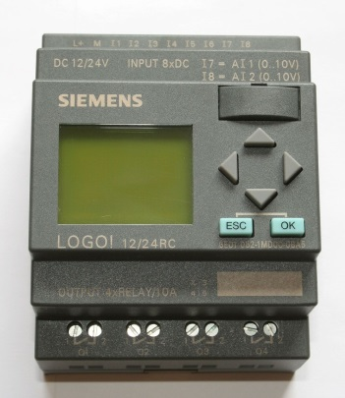
Electric drive and its basic elements
Three-phase transmission line
Convertor
Motor
Gear box
Machine tool
Transducer
Transducer
Transducer
Reference signals
Feedback
signals
Feedback
signals
Transducer
Controller
Reference signals
Feedback signals

Slide 6
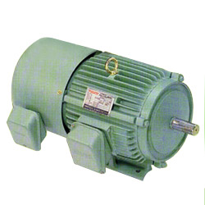
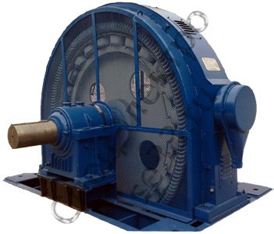
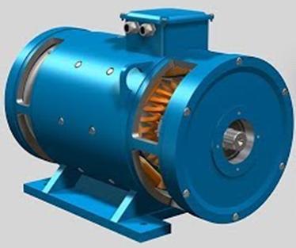
Types of electric motors
Function: transformation of electric energy into mechanical
ac motor
synchronous motor
dc motor

Slide 7

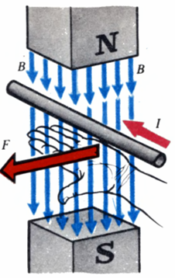
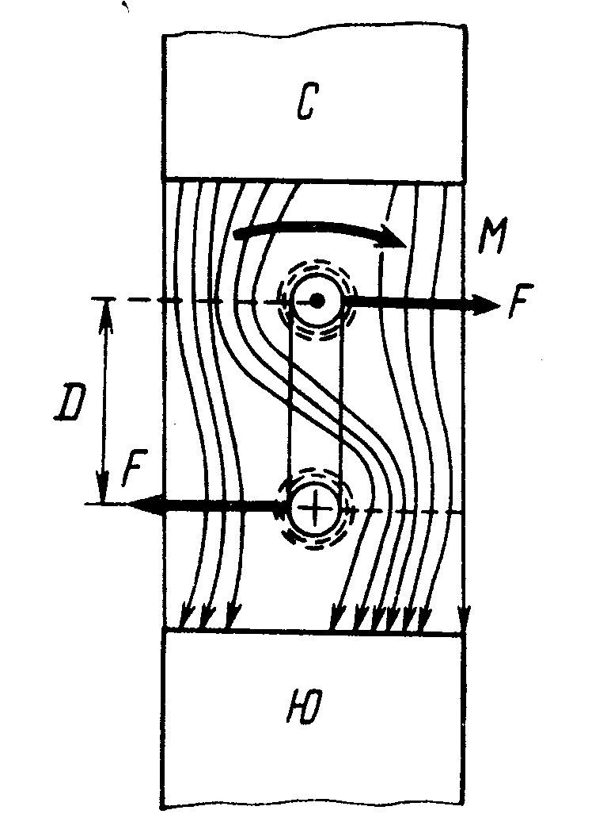
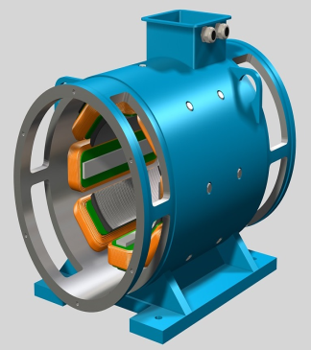
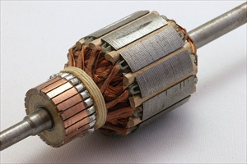
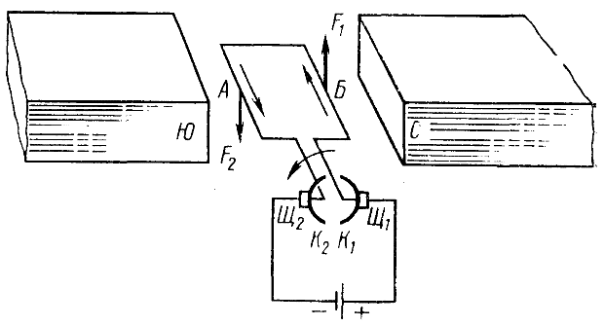


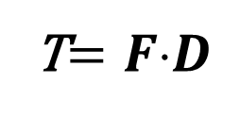
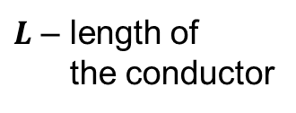



DC motor
N
T
Stator
Armature
S
F₂
$$F=BIL$$
T$=FD$
S
N
$B$- induction
F₁
$F$ - force
$I$ - current
T - torque
Br₂
Br₁
$L$– lengthof
the conductor
$D$ - diameter
C₂
C₁

Slide 8
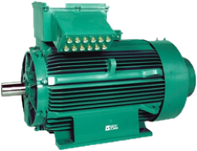
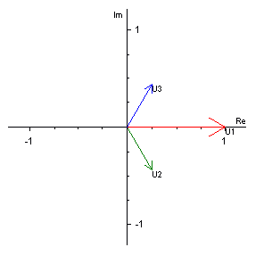
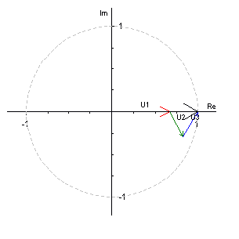
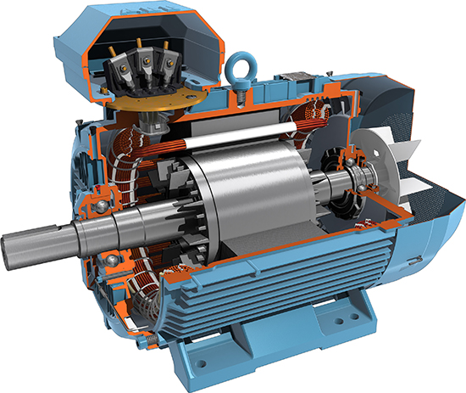
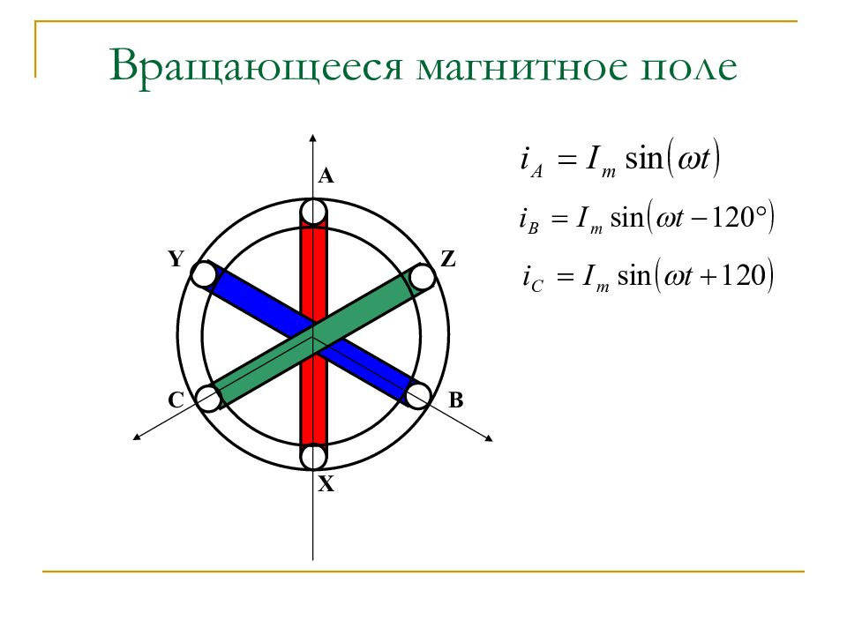
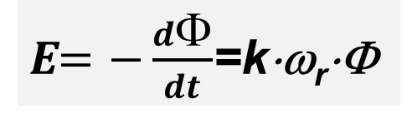
AC motor
A₁
A₁
B₂
C₂
B₂
C₂
Rotor
C₁
B₁
C₁
B₁
A₁
A₁
Stator
E$=−\frac{dΦ}{dt}$=k⋅ω_{r}⋅Φ

Slide 9
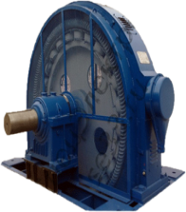
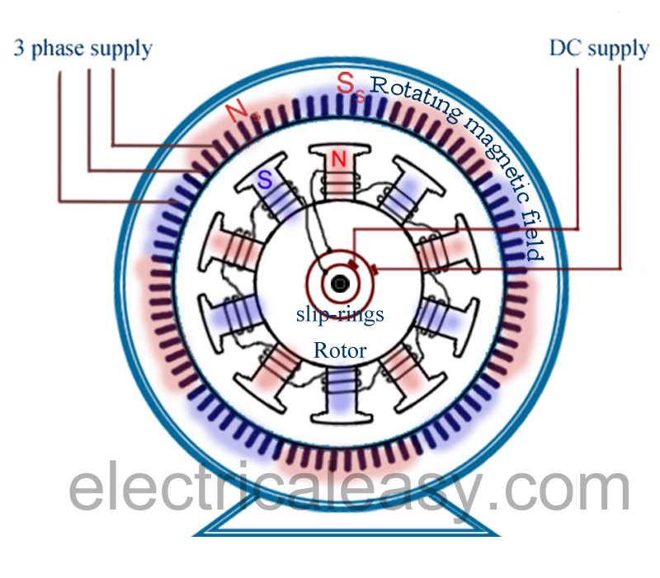
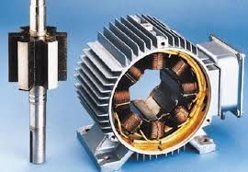
Synchronous motor
Synchronous motor with exiting winding
Synchronous motor with permanent magnets

Slide 10
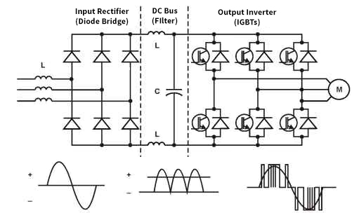
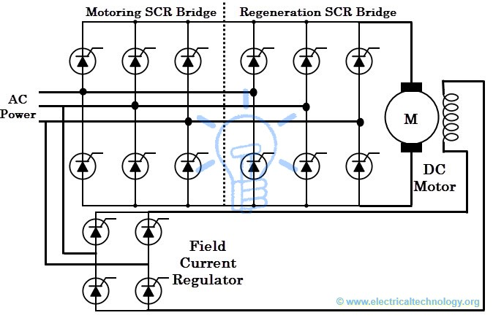
Converters
Function: conversion of electrical energy of one type into electrical energy of another type
Rectifier
Inverter

Slide 11
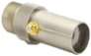
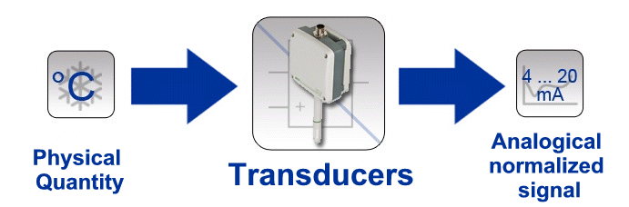
Transducers
Function: conversion of signals of various nature into standard electrical signals

Slide 12
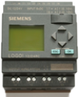
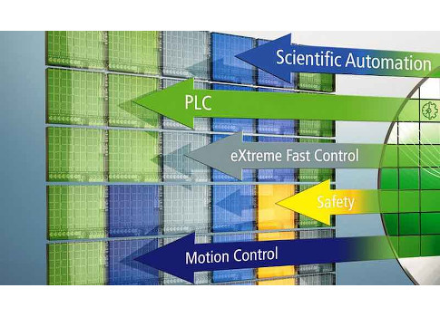
Controllers
Function: equipping machine-tools with control and automation functions
industrial PC (IPC),
programmable logic controller (PLC),
programmable automation controller (PAC)

Slide 13
Basic concepts and determinations
Classification of electric drives

Slide 14

Classification of electric drives
By the sort of current of drive engine:
direct current (DC)
alternating current (AC)

Slide 15
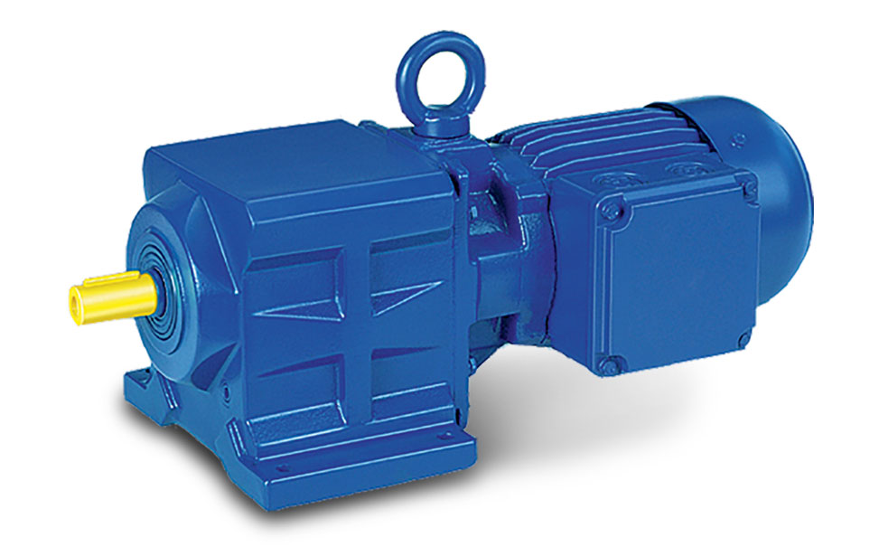
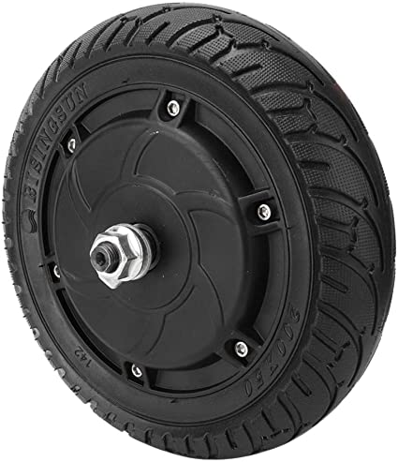
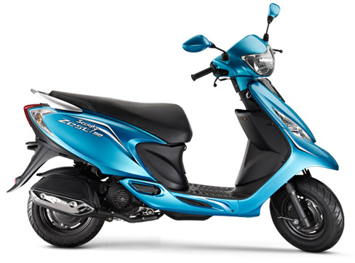
Classification of electric drives
By the sort of mechanical transmission:
geared electric drive in which an electric motor is connected with a working machine by means of one of types of transmission devices
gearless electric drive (direct drive), when an electric motor is connected directly with a machine tool
Motor
Gear box

Slide 16
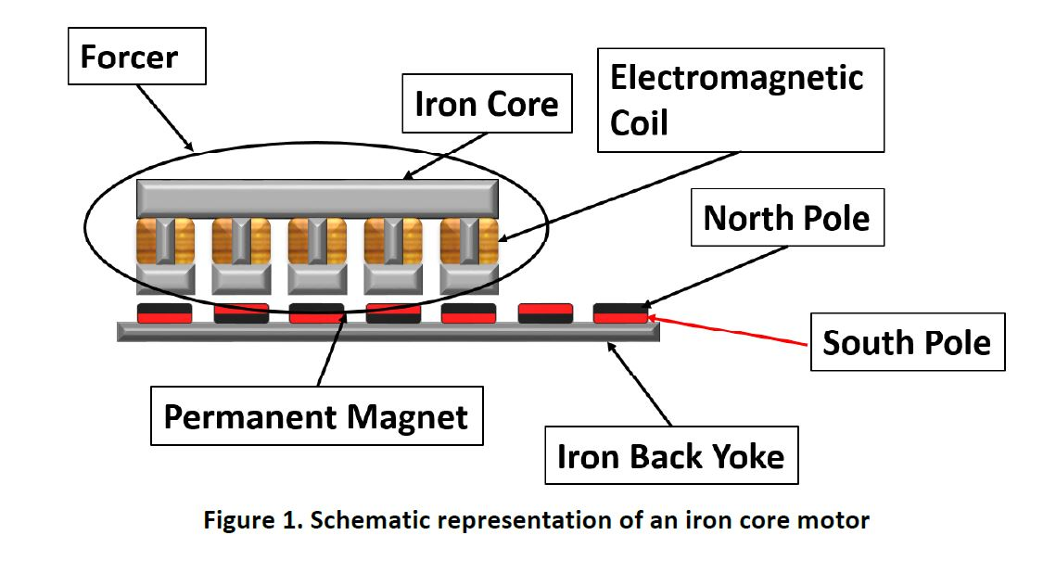
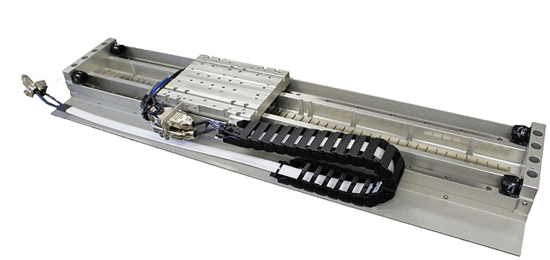
Classification of electric drives
By the type of motion:
unidirectional and reversing rotating
unidirectional and reversing linear motion
Linear motion
Forcer
Permanent Magnet

Slide 17
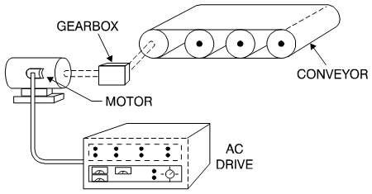
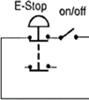
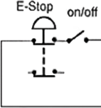
Classification of electric drives
By the level of automation:
uncontrolled electric drive
automated electric drive in which a part of control operations is executed without operator participation;
automatic electric drive, in which full control operations are executed without operator participation.
a)
b)
c)
transducers
transducers

Slide 18
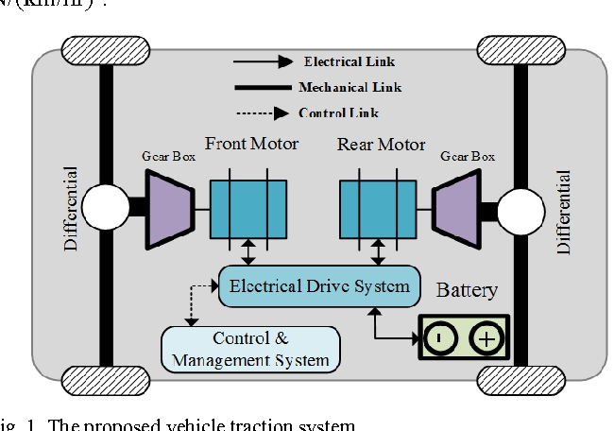
Classification of electric drives
By the type of control system:
open-loop control. It is an electric drive control system in which a feed-back of output coordinate absents;
closed-loop control. It is an electric drive control system in which a feed-back of output coordinate presents;
electric shaft − it is an interconnected electric drive which provides synchronous motion two or more machine tools, not having a mechanical connection.
a)
b)
c)
transducers

Slide 19

Classification of electric drives
By principles of output coordinates control:
controllable electric drive which provides a guided change of machine tool motion coordinates in accordance with requirements of a technological process;
positional electric drive which provides a machine tool transferring to a set position;
follow-up electric drive which provides a machine tool moving in accordance with an arbitrarily changing reference signal;
software programmable electric drive which provides a machine tool moving in accordance with a set program;
adaptive electric drive which automatically adapts to parameters changing and disturbance influences, by a structure and parameters changing of a control system.
ω_{r}
a)
ED
MT
ω
ϕ_{r}
b)
ED
MT
ϕ
ϕ_{r}(t)
c)
ED
MT
ϕ(t)
ω_{r},ϕ_{r}
d)
ED
MT
ω,ϕ
ω_{r}
T_{L}(t)
e)
ED
MT
ω(t)

Slide 20
Classification of electric drives
ω_{r}
By a method of passing to mechanical energy:
individual electric drive − only one machine tool is operated by one engine;
group electric drive − a few machine tools are operated by one engine;
multimotor electric drive − one machine tool is operated by a few electric motors;
interconnected electric drive − an electric drive contains two or a few electric or mechanically connected electric drives, during working of which a set correlation of their speeds, loadings or positions of machine tools is supported.
a)
ED
MT
ω
ω_{r}
MT1
b)
ED
MT2
MT3
ED
M1
M2
M3
ω
ω_{r}
c)
MT
ω
ω_{r}
ED1
d)
ED2
MT
ED3
ω

Slide 21
Basic concepts and determinations
Basic directions of electric drive development

Slide 22
Basic directions of electric drive development
Expansion of automated drives, mainly frequency controlled drives of alternating current with a usage of the fully controlled semiconductor devices
Increase of requirements to accuracy indexes of dynamic and static modes of operations
Expansion and complication of electric drives functions
Expansion of functional possibilities of an electric drive in different production operations and technological processes by application of the numerical control systems and microprocessor devices
Standardization of an element base and creation of a complete electric drive for requirements satisfying of a wide class of production mechanisms
Expansion of power ratings to ten of thousands of kilowatts and considerable variety of their design
Creation of powerful gearless drives of ball and autogenous mills, mine winder, basic mechanisms of excavators and other mechanisms
Increase efficiency and power factor of all electric drive types
Usage of grouped electric drive systems with a common supply for flexible control of electric power streams, energy storage, reactive power compensation etc.

Slide 23
AC DRIVES
AC motor Drives are used in many industrial and domestic application, such as in conveyer, lift, mixer, escalator etc.
The AC motor have a number of advantages :
Lightweight (20% to 40% lighter than equivalent DC motor)
Inexpensive
Low maintenance
The Disadvantages AC motor :
* The power control relatively complex and more expensive
There are two type of AC motor Drives :
Induction Motor Drives
Synchronous Motor Drives

Slide 24
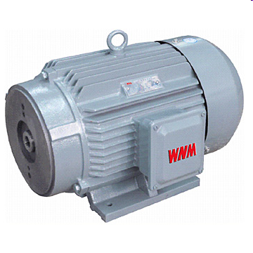
INDUCTION MOTOR DRIVES
Three-phase induction motor are commonly used in adjustable-speed drives (ASD).
Basic part of three-phase induction motor :
Stator
Rotor
Air gap

Slide 25
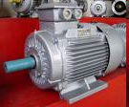
The stator winding are supplied with balanced three-phase AC voltage, which produce induced voltage in the rotor windings. It is possible to arrange the distribution of stator winding so that there is an effect of multiple poles, producing several cycle of magnetomotive force (mmf) or field around the air gap.
The speed of rotation of field is called the synchronous speed ω_{s} , which is defined by :
ω_{s} is syncronous speed [rad/sec]
N_{s} is syncronous speed [rpm]
p is numbers of poles
ω is the supply frequency [rad/sec]
f is the supply frequency [Hz]
N_{m} is motor speed
or

Slide 26
The motor speed
The rotor speed or motor speed is :
Where S is slip, as defined as :
Or

Slide 27
Equivalent Circuit Of Induction Motor
Where :
Rs is resistance per-phase of stator winding
Rr is resistance per-phase of rotor winding
Xs is leakage reactance per-phase of the winding stator
Xs is leakage reactance per-phase of the winding rotor
X_{m} is magnetizing reactance
R_{m is} Core losses as a reactance

Slide 28
Performance Characteristic of Induction Motor
Stator copper loss :
Rotor copper loss :
Core losses :

Slide 29
Performance Characteristic of Induction Motor
Power developed on air gap (Power fropm stator to
rotor through air gap) :
Power developed by motor :
or
Torque of motor :
or
or

Slide 30
Performance Characteristic of Induction Motor
Input power of motor :
Output power of motor :
Efficiency :

Slide 31
Performance Characteristic of Induction Motor
If
and
so, the efficiency can calculated as :

Slide 32
Performance Characteristic of Induction Motor
Generally, value of reactance magnetization X_{m} >> value Rm (core losses) and also
So, the magnetizing voltage same with the input voltage :
Therefore, the equivalent circuit is ;
Xm

Slide 33
Performance Characteristic of Induction Motor
Total Impedance of this circuit is :
Xm
The rotor current is :

Slide 34
Torque – speed Characteristic

Slide 35
Three region operation :
Motoring :
Regenerating :
Plugging :

Slide 36
Performance Characteristic of Induction Motor
Starting speed of motor is ωm = 0 or S = 1,
Starting torque of motor is :
Slip for the maximum torque S_{max} can be found by setting :
So, the slip on maximum torque is :

Slide 37
Performance Characteristic of Induction Motor
Torque maximum is :
And the maximum regenerative torque can be found as :
Where the slip of motor s = - S_{m}

Slide 38
Speed-Torque Characteristic :
For the high Slip S. (starting)
So, the torque of motor is :
And starting torque (slip S=1) is :

Slide 39
For low slip S region, the motor speed near unity or synchronous speed, in this region the impedance motor is :
So, the motor torque is :
And the slip at maximum torque is :
The maximum motor torque is :

Slide 40
Stator Voltage Control
Controlling Induction Motor Speed by Adjusting The Stator Voltage

Slide 41
Frequency Voltage Control
Controlling Induction Motor Speed by Adjusting The Frequency Stator Voltage

Slide 42
If the frequency is increased above its rated value, the flux and torque would decrease. If the synchronous speed corresponding to the rated frequency is call the base speed ω_{b,} the synchronous speed at any other frequency becomes:
And :
The motor torque :

Slide 43
If R_{s} is negligible, the maximum torque at the base speed as :
And the maximum torque at any other frequency is :
At this maximum torque, slip S is :
Normalizing :
And

Slide 44
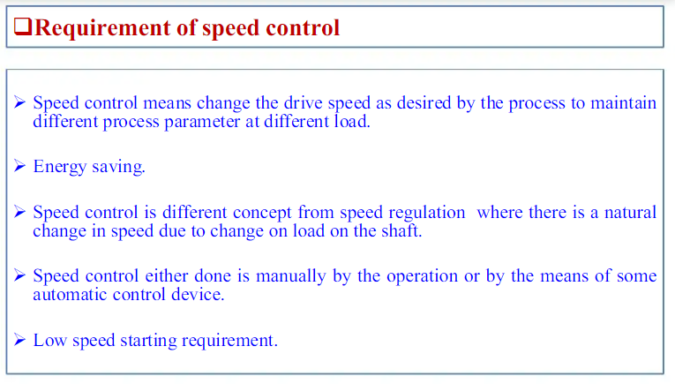

Slide 45
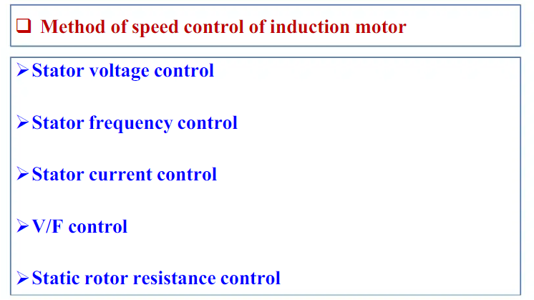

Slide 46
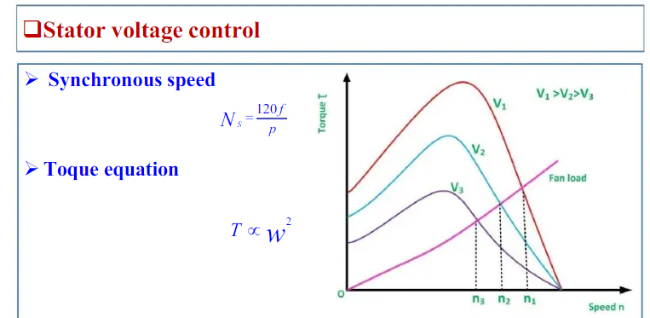

Slide 47
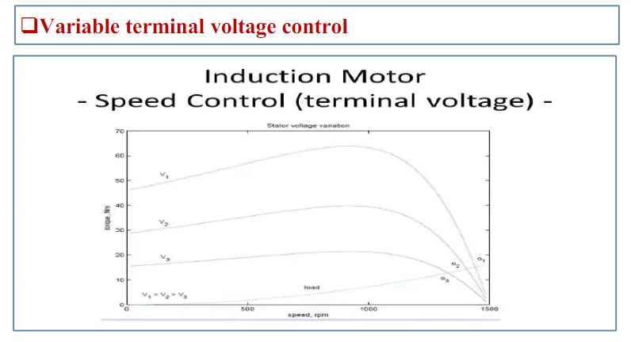

Slide 48
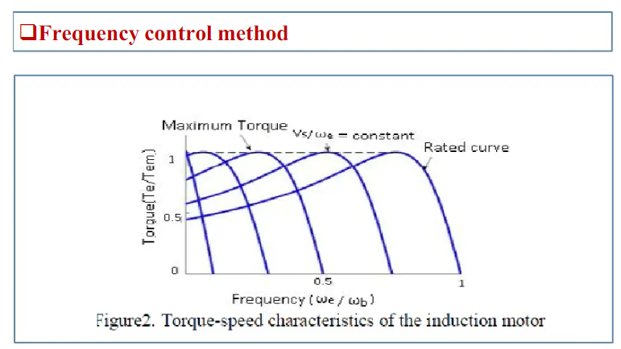

Slide 49
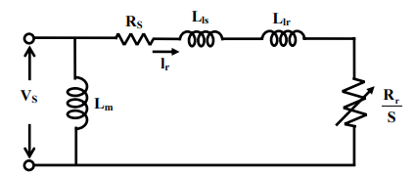


Approximate per phase equivalent circuit

Slide 50


Slide 51


Slide 52


Slide 53
BLDC Motors
A BLDC motor accomplishes commutation electronically using rotor position feedback to determine when to switch the current. The structure is shown in Figure.
Feedback usually entails an attached Hall sensor or a rotary encoder.
The stator windings work in conjunction with permanent magnets on the rotor to generate a nearly uniform flux density in the air gap.
This permits the stator coils to be driven by a constant DC voltage (hence the name brushless DC), which simply switches from one stator coil to the next to generate an AC voltage waveform with a trapezoidal shape.

Slide 54


Slide 55


Slide 56
BLDC motors
Some BLDC motors incorporate Hall sensors to detect the rotor position. These sensors provide feedback to the electronic controller, enabling precise commutation timing and improved motor performance.
BLDC motors are widely used in industrial automation systems, such as robotics, CNC machines, and conveyor systems. Their high torque density, precise control, and low maintenance make them ideal for such applications.

Slide 57
Speed Control of BLDC Motors
Speed control of BLDC (Brushless DC) motors can be achieved using various control methods, including sensor or sensorless control, square-wave control, PWM (Pulse Width Modulation) control, and more advanced control strategies such as PI (Proportional-Integral) and PID (Proportional-Integral-Derivative) controllers.
In sensor-based control, the motor uses feedback from sensors such as hall-effect sensors, which detect the rotor position and provide an electrical signal to the motor controller, allowing it to control the speed and direction of the motor.
Unlike a brushed DC motor, the commutation of a BLDC motor is controlled electronically. To rotate the BLDC motor, the stator windings should be energized in a sequence. It is important to know the rotor position in order to understand which winding will be energized following the energizing sequence. Rotor position is sensed using Hall effect sensors embedded into the stator. Most BLDC motors have three Hall sensors embedded into the stator on the non-driving end of the motor. Whenever the rotor magnetic poles pass near the Hall sensors, they give a high or low signal, indicating the N or S pole is passing near the sensors. Based on the combination of these three Hall sensor signals, the exact sequence of commutation can be determined.

Slide 58
Speed Control of BLDC motors
In sensorless control, rotor position information can be obtained using other measurable parameters such as back electromotive force or stator current, without the need for additional sensors.
Square-wave control is a simple control method that involves switching the voltage applied to the motor on and off in a square wave pattern. This method is inexpensive and can provide high motor speeds.
PWM control involves adjusting the power delivered to the motor by varying the duty cycle of a high-frequency pulse train. This method provides accurate speed control and can be used with sensor or sensorless systems.
In more advanced control strategies such as PI and PID control, the motor controller adjusts the power delivered to the motor based on feedback from sensors or other sources, incorporating proportional, integral, and derivative terms to provide precise control of motor speed.

Slide 59
Applications
Automotive: BLDC motors are employed in electric vehicles (EVs) for propulsion, power steering, braking systems, and HVAC systems. They offer higher efficiency, reduced noise, and improved reliability compared to traditional brushed motors.
Appliances: BLDC motors are found in household appliances like refrigerators, washing machines, and air conditioners. They provide energy-efficient operation, quieter performance, and longer lifespan compared to conventional motors.
Aerospace and Drones: BLDC motors are used in aerospace applications, including actuators, flight control systems, and auxiliary power units (APUs). They are also integral components of drones, where their compact size and high power density are advantageous.
Medical Equipment: BLDC motors are employed in medical devices such as surgical tools, infusion pumps, and laboratory equipment. Their precise control, compact size, and low electromagnetic interference make them suitable for medical applications.
Consumer Electronics: BLDC motors are utilized in various consumer electronics, including computer cooling fans, hard disk drives, and printers. They offer efficient and reliable performance in compact form factors.

Slide 60


Slide 61


Slide 62
References
Electrical Machine Drives, NPTEL Reference Material, 2019
Alexander Beshta, Lecture material on Fundamentals of Electric Drives, ttp://do.nmu.org.ua/course/index.php?categoryid=11
P Sai Kumar, Lecture Material, Special Electrical Machines, GVPCE(A), 2019.
https://www.monolithicpower.com/media/document/Brushless_DC_Motor_Fundamentals.pdf

Slide 63
References
Singh, Surya & Singh, Krishna & Verma, K & Singh, Jaswant & Tiwari, Naveen. (2021). A Review on Control of a Brushless DC Motor Drive.

Slide 64
Thank you
Queries?

